Slide 1
IT Professional Environment: Law, Ethics and Privacy
Week 8:
Lecturer: Dr. Farshid Keivanian

Slide 2
Introduction to Intellectual Property (IP)
Introductory Content:
Intellectual Property (IP) is a crucial concept in today’s technology-driven world. It refers to creations of the mind, such as inventions, literary and artistic works, designs, and symbols used in commerce. Understanding IP is essential for protecting innovation and securing financial benefits.

Slide 3
Introduction to Intellectual Property (IP)
Practical Scenario:
Consider a Sydney-based startup that develops a unique software tool for managing small business finances. This tool represents a creation of the mind and is protected under IP law. The startup needs to protect this software through copyright to prevent unauthorized use.
Class Discussion Question:
How do you think IP protection can influence a company’s success, especially in the tech industry?

Slide 4
Introduction to Intellectual Property (IP)
Response: IP protection can safeguard innovations, allowing companies to maintain a competitive edge, generate revenue through licensing, and prevent unauthorized use.

Slide 5
IP Ownership
Introductory Content:
IP ownership can be complex, especially in technology where multiple parties may contribute to a single product. Understanding the relationship between creators, businesses, and external agencies is critical in determining IP ownership.

Slide 6
IP Ownership
Practical Scenario:
Imagine an app developed by a team of freelancers for a Brisbane-based tech company. Who owns the IP: the freelancers or the company?
Class Discussion Question:
In such a scenario, how should the IP rights be managed to avoid future disputes?

Slide 7
IP Ownership
Response: IP ownership should be clearly defined in contracts, with freelancers typically transferring IP rights to the company upon completion of the project.

Slide 8
IP Risks
Introductory Content:
Misunderstanding IP can lead to significant risks, including legal disputes and financial losses. Recognizing, recording, and mitigating these risks are essential steps in managing IP effectively.

Slide 9
IP Risks
Practical Scenario:
A Melbourne-based company unknowingly uses copyrighted images in its marketing materials. What risks does this company face?
Class Discussion Question:
How can companies mitigate risks associated with IP?

Slide 10
IP Risks
Response: Companies should conduct IP audits, ensure proper licensing, and educate employees on IP laws to avoid infringement and associated penalties.

Slide 11
IP Protection
Introductory Content:
Protecting IP is not just about registering patents or copyrights; it’s about creating barriers that competitors cannot easily cross. This protection can be costly, but recognizing its value is essential.

Slide 12
IP Protection
Practical Scenario:
Consider a Canberra-based tech firm that develops a new encryption algorithm. How should the company protect its IP to ensure it remains competitive?
Class Discussion Question:
Why might a company hesitate to invest in IP protection, and what could be the consequences?

Slide 13
IP Protection
Response: High costs may deter investment, but the lack of protection can lead to loss of competitive advantage and potential legal battles.

Slide 14
IP for Technology
Introductory Content:
In the tech industry, IP has increasingly gained value over physical assets. IP rights apply to data, intangible assets, and innovative systems, making it crucial for tech companies to safeguard their creations.

Slide 15
IP for Technology
Practical Scenario:
A software development company in Sydney creates a new data management system. How should they protect this system from software piracy?
Class Discussion Question:
What steps can tech companies take to protect their IP from piracy?

Slide 16
IP for Technology
Response: Regular IP audits, clear IP strategies, robust cybersecurity measures, and strict confidentiality agreements can help protect IP from piracy and unauthorized access.

Slide 17
Managing IP in Technology
Introductory Content:
Managing IP in the tech industry involves more than just filing for IP rights. It includes creating a comprehensive IP strategy, conducting regular audits, and safeguarding innovation through cybersecurity.

Slide 18
Managing IP in Technology
Practical Scenario:
A Brisbane-based company experiences a cyberattack that compromises its proprietary software code. What steps should the company have taken to protect its IP?
Class Discussion Question:
How can regular IP audits and strong cybersecurity measures prevent IP theft in technology?

Slide 19
Managing IP in Technology
Response: Regular audits help identify potential vulnerabilities, while strong cybersecurity measures protect against unauthorized access and theft of intellectual property.

Slide 20
Group Class Activity – Presentation Calibri Size 28 (f.keivanian@aapoly.edu.au)
Group Activity:
Task:
In group, create a detailed IP strategy for a hypothetical tech startup based in Melbourne. Each group member will focus on one aspect of the strategy (e.g., patent filing, IP audits, cybersecurity measures). Afterward, present your strategy to the class and discuss the potential challenges and solutions.

Slide 21
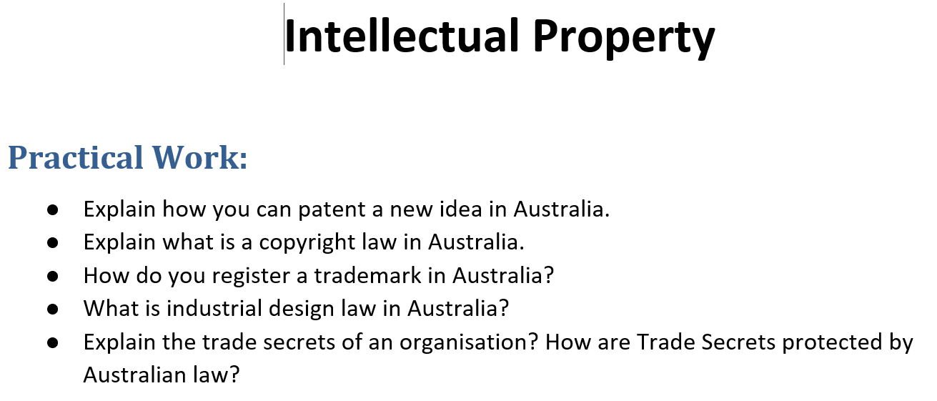
Tutorial Week 8

Slide 22
Tutorial Week 8
Practical Work: Intellectual Property in Australia
1. How You Can Patent a New Idea in Australia
Explanation: To patent a new idea in Australia, you need to follow these steps:
Step 1: Ensure Your Idea is Patentable: Not all ideas can be patented. Your idea must be new, involve an inventive step, and be useful. It should not have been publicly disclosed before applying for the patent.

Slide 23
Tutorial Week 8
Step 2: Conduct a Patent Search: Check existing patents to ensure your idea has not already been patented. This can be done through IP Australia’s online database or by hiring a patent attorney.
Step 3: Prepare a Patent Application: You need to file either a provisional application (which gives you 12 months to file a complete application) or a complete application directly. A patent attorney can help draft the application to ensure it covers all aspects of your invention.

Slide 24
Tutorial Week 8
Step 4: File the Application with IP Australia: Submit your application online via IP Australia’s eServices portal, paying the required fees.
Step 5: Examination: IP Australia will examine your application to ensure it meets all the requirements. This process may take several years, during which you may need to respond to any objections raised by the examiner.
Step 6: Patent Grant: If your application is successful, your patent will be granted, giving you exclusive rights to your invention for up to 20 years.

Slide 25
Tutorial Week 8
2. What is Copyright Law in Australia?
Explanation: Copyright law in Australia protects the expression of ideas rather than the ideas themselves. It covers a wide range of works, including literary, artistic, musical, and dramatic works, as well as films, broadcasts, and software. Key points about copyright law in Australia include:

Slide 26
Tutorial Week 8
Automatic Protection: Copyright protection is automatic as soon as the work is created and does not require registration.
Duration: Copyright generally lasts for 70 years after the death of the creator.
Exclusive Rights: The copyright owner has the exclusive right to reproduce, publish, perform, communicate, and adapt the work.
Infringement: Unauthorized use of copyrighted material is considered infringement, which can result in legal action.

Slide 27
Tutorial Week 8
3. How to Register a Trademark in Australia
Explanation: To register a trademark in Australia, follow these steps:
Step 1: Search Existing Trademarks: Use IP Australia’s ATMOSS database to search for existing trademarks to ensure your proposed trademark is unique.
Step 2: Decide on the Trademark: Your trademark can be a word, phrase, logo, or a combination. Ensure it is distinctive and not descriptive of the goods or services.

Slide 28
Tutorial Week 8
Step 3: File the Application: Submit a trademark application online through IP Australia’s eServices portal, specifying the classes of goods or services your trademark will cover.
Step 4: Examination: IP Australia will examine your application to ensure it complies with the law and does not conflict with existing trademarks.
Step 5: Publication and Opposition: If your application passes the examination, it will be published in the Australian Official Journal of Trade Marks. Third parties have two months to oppose the registration.

Slide 29
Tutorial Week 8
Step 6: Registration: If no opposition is filed, or if any opposition is resolved, your trademark will be registered, giving you exclusive rights for 10 years, with the option to renew.

Slide 30
Tutorial Week 8
4. What is Industrial Design Law in Australia?
Explanation: Industrial design law in Australia protects the visual design of objects that are not purely utilitarian. This can include the shape, configuration, pattern, or ornamentation of a product. Key aspects of industrial design law include:

Slide 31
Tutorial Week 8
Registration Requirement: Unlike copyright, industrial design protection requires registration.
Novelty Requirement: The design must be new and distinctive, meaning it should not have been disclosed to the public before filing.
Duration: Registered designs are protected for an initial period of five years, with the possibility of renewal for a further five years, providing up to 10 years of protection.
Rights: The registered owner has the exclusive right to use, license, or sell the design.

Slide 32
Tutorial Week 8
5. What are Trade Secrets, and How are They Protected by Australian Law?
Explanation: Trade secrets are confidential business information that provides a company with a competitive edge. This can include formulas, practices, processes, designs, instruments, or a compilation of information. Trade secrets are not registered but are protected through legal means, such as:

Slide 33
Tutorial Week 8
Non-Disclosure Agreements (NDAs): Companies often require employees, partners, and vendors to sign NDAs to legally bind them to confidentiality.
Employment Contracts: Clauses in employment contracts can prevent employees from disclosing or using trade secrets after they leave the company.
Common Law: Under common law, companies can sue for breach of confidence if a trade secret is disclosed without permission.
Injunctions: Courts can issue injunctions to prevent the misuse or disclosure of trade secrets.

Slide 34
Tutorial Week 8
Trade secrets remain protected as long as they remain confidential, unlike patents, which have a fixed term of protection.

Slide 35
Step-by-Step Guide to Excel in Assessment 3: Evaluate Business Risk
Overview
This guide will help you achieve a high distinction in your Assessment 3 for ICT406, focusing on evaluating business risks for a law firm that has recently suffered a data breach. The assessment requires a thorough analysis of sensitive data, legal responsibilities, privacy laws, and the advantages and disadvantages of technology in a law firm.

Slide 36
Step-by-Step Guide to Excel in Assessment 3: Evaluate Business Risk
Step 1: Understand the Task and Requirements
Case Study Overview: Begin by carefully reading the case study provided in your assessment document. Understand the context of the law firm, the nature of the data breach, and the areas of law involved.
Assignment Requirements:
Identify sensitive data in the context of a law firm.
Outline the major responsibilities of the law firm.
Review the firm's privacy and security policies and discuss its responsibilities in the event of a data breach.
Analyze the advantages and disadvantages of technology in a law firm.
Apply Australian breach of privacy laws to this scenario.
Discuss the ethical implications linked to privacy breaches.

Slide 37
Step-by-Step Guide to Excel in Assessment 3: Evaluate Business Risk
Step 2: Research and Gather Information
Legal Framework: Research Australian privacy laws, particularly the Privacy Act 1988 and any relevant amendments. Focus on how these laws apply to data breaches.
Technology in Law Firms: Investigate the role of technology in law firms, including the benefits it brings and the risks it poses. Look into examples of data breaches in similar firms to provide context.
Ethics and Privacy: Explore the ethical considerations surrounding client privacy in law firms, including how ethical frameworks guide the protection of sensitive information.

Slide 38
Step-by-Step Guide to Excel in Assessment 3: Evaluate Business Risk
Step 3: Structure Your Report
Your report should include the following sections:
Cover Page: Include your subject name and number, assignment number, your name, and student ID.
Table of Contents: Use the Word tool to generate a table of contents.
Introduction: Provide a brief overview of the case study, your goals, and the objectives of your analysis.
Tasks:
Sensitive Data: List and explain the types of sensitive data a law firm handles.
Responsibilities: Discuss the law firm's responsibilities concerning data protection and client privacy.
Privacy and Security Policy: Evaluate the privacy and security policy of the law firm and outline its responsibilities after a data breach.
Technology Analysis: Discuss the pros and cons of technology use in law firms.
Australian Privacy Law: Explain how Australian privacy laws apply to the data breach scenario.
Ethical Implications: Analyze the ethical issues related to privacy breaches and how they affect client trust.
Conclusion: Summarize your findings, emphasizing the importance of robust privacy practices in law firms.
References: Include all sources you referenced in APA 7th style.

Slide 39
Step-by-Step Guide to Excel in Assessment 3: Evaluate Business Risk
Step 4: Focus on the Rubric
Executive Summary: Ensure it concisely summarizes the key findings and recommendations.
Risk Identification: Identify all relevant risks associated with the data breach.
Risk Analysis: Provide a detailed analysis of each identified risk, using appropriate risk scoring.
Control Assessment: Evaluate the effectiveness of current controls and identify gaps.
Recommendations: Propose actionable and prioritized recommendations to mitigate the identified risks.
Presentation & Formatting: Ensure your report is well-organized, professional, and free of errors.
Citations & References: Properly cite all sources in APA 7th format.

Slide 40
Step-by-Step Guide to Excel in Assessment 3: Evaluate Business Risk
Step 5: Writing the Report
Clarity and Conciseness: Write in a clear and concise manner, avoiding jargon where possible. Ensure that each section of your report logically follows from the previous one.
Use Examples: Where applicable, use real-world examples or case studies to support your analysis.
Logical Flow: Make sure your report has a logical structure, with each section building on the previous one.

Slide 41
Step-by-Step Guide to Excel in Assessment 3: Evaluate Business Risk
Step 6: Review and Revise
Proofreading: Carefully proofread your report for any grammatical errors, typos, or inconsistencies.
Rubric Cross-Check: Compare your report against the rubric criteria to ensure you have covered all aspects required for a high distinction.
Seek Feedback: Use tools like Studiosity to get feedback on your assignment.

Slide 42
Step-by-Step Guide to Excel in Assessment 3: Evaluate Business Risk
Step 7: Seek Assistance
Study Help Resources: Utilize the Study Help materials available to refine your research, writing, and referencing skills.
Ask Questions: Don’t hesitate to reach out to your lecturer or peers if you have questions or need clarification on any part of the assessment.

Slide 43
Step-by-Step Guide to Excel in Assessment 3: Evaluate Business Risk
Step 8: Submit on Time
Turnitin Submission: Ensure your assignment is submitted through Turnitin by the deadline. Early submission is recommended to avoid last-minute issues.
Practical Example for Practice:
Scenario: A financial institution is implementing a new customer relationship management (CRM) system. Identify and evaluate the risks associated with the data migration process from the old system to the new one. Propose recommendations using the COBIT framework to mitigate these risks.
By following these steps and utilizing the provided resources, you will be well-prepared to excel in your Assessment 3 and aim for a high distinction mark. Good luck!

Slide 44
Contents | Excellent | Good | Fair | Poor | Points
Cover Page (1 Mark) | Include subject name, number, assignment number, team number, team members name & id | Include assignment number, team members name and Id | Include team members name & id | Cover page not included
Table of Contents (1 Mark) | Insert by word including title, content name, page number | Manually created by student including title, content name and page number | Include contents | No table of contents
Introduction (2 Marks) | Comprehensive explanation of background and objective and goals of the project. | Clear presentation of the background and objective of the project. | Justified presentation of the background and objective of the project. | No introduction or poorly presented materials of background and objective of the project.
Question 1 (2 Marks) | Professional answer to the list of enquiries that could satisfy the need of the project in the real world. | Clear answer that satisfies the need of the project, but it is not applicable in the real world. | An answer that needs explanation or justification for further clarification and has a missing satisfying response. | An answer that does not provide a full picture for the expected outcome.

Slide 45
Contents | Excellent | Good | Fair | Poor | Points
Question 2 (2 Marks) | Professional answer to the list of enquiries that could satisfy the need of the project in the real world. | Clear answer that satisfies the need of the project, but it is not applicable in the real world. | An answer that needs explanation or justification for further clarification and has a missing satisfying response. | An answer that does not provide a full picture for the expected outcome.
Question 3 (2 Marks) | Professional answer to the list of enquiries that could satisfy the need of the project in the real world. | Clear answer that satisfies the need of the project, but it is not applicable in the real world. | An answer that needs explanation or justification for further clarification and has a missing satisfying response. | An answer that does not provide a full picture for the expected outcome.
Question 4 (2 Marks) | Professional answer to the list of enquiries that could satisfy the need of the project in the real world. | Clear answer that satisfies the need of the project, but it is not applicable in the real world. | An answer that needs explanation or justification for further clarification and has a missing satisfying response. | An answer that does not provide a full picture for the expected outcome.

Slide 46
Contents | Excellent | Good | Fair | Poor | Points
Question 5 (2 Marks) | Professional answer to the list of enquiries that could satisfy the need of the project in the real world. | Clear answer that satisfies the need of the project, but it is not applicable in the real world. | An answer that needs explanation or justification for further clarification and has a missing satisfying response. | An answer that does not provide a full picture for the expected outcome.
Question 6 (2 Marks) | Professional answer to the list of enquiries that could satisfy the need of the project in the real world. | Clear answer that satisfies the need of the project, but it is not applicable in the real world. | An answer that needs explanation or justification for further clarification and has a missing satisfying response. | An answer that does not provide a full picture for the expected outcome.
Conclusion (2 Marks) | Exceptional critical thinking to conclude the work. Providing a deep evaluation analysis and thought demonstrated in the project. | Professional critical thinking to conclude the overall requirements of the project. | Reasonably critical thinking to conclude the project. | Very basic conclusion with minimum definition of overall work to finalise the project.

Slide 47
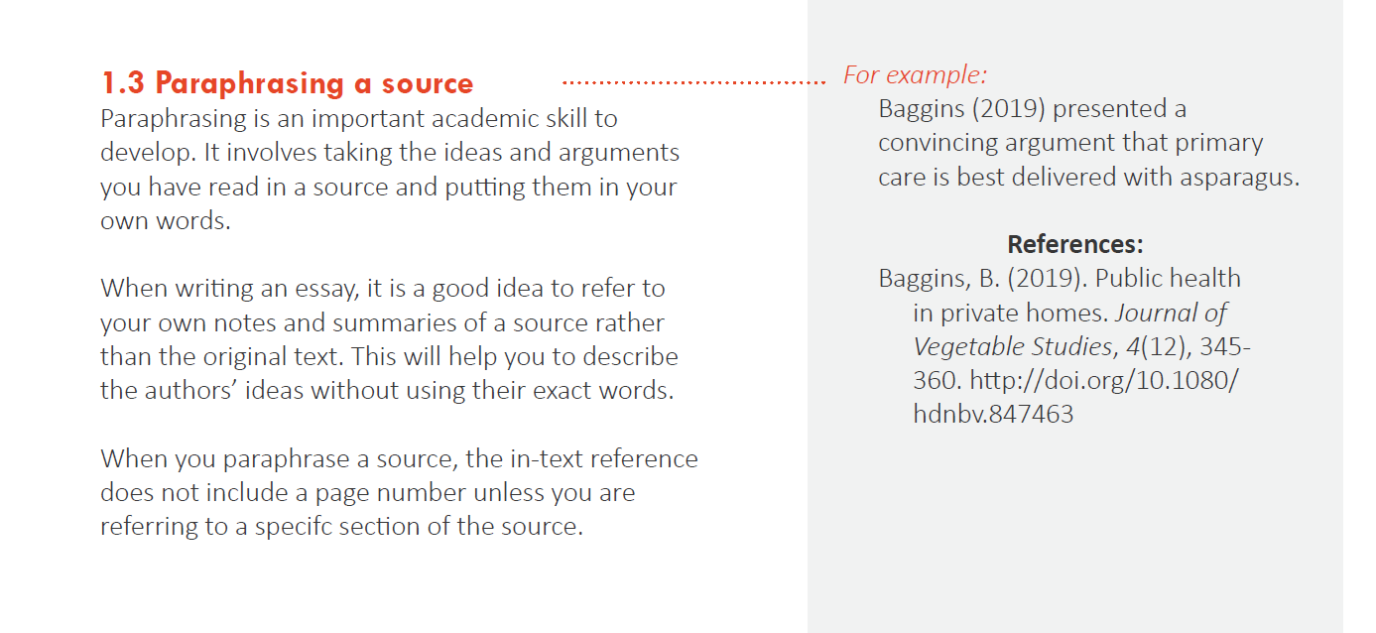
Contents | Excellent | Good | Fair | Poor | Points
Reference (2 Marks) | This is a very important part of any work presented at AAPOLY. The report must be clearly referenced in APA style (https://apastyle.apa.org/). The reports automatically will be reviewed by Turnitin after submission for using of AI technology and similarity of the work across the World Wide Web.
Total Points

Slide 48
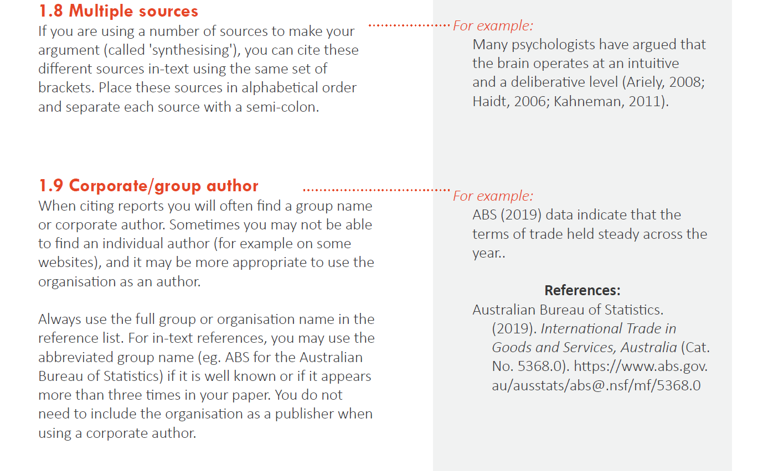

Slide 49
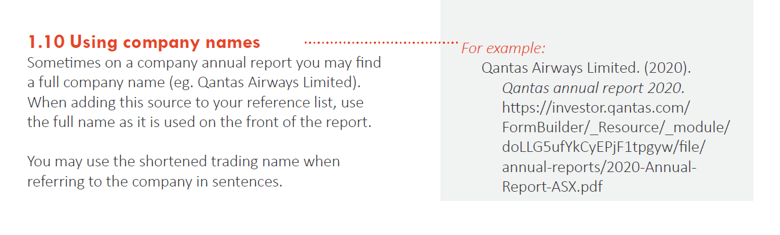

Slide 50
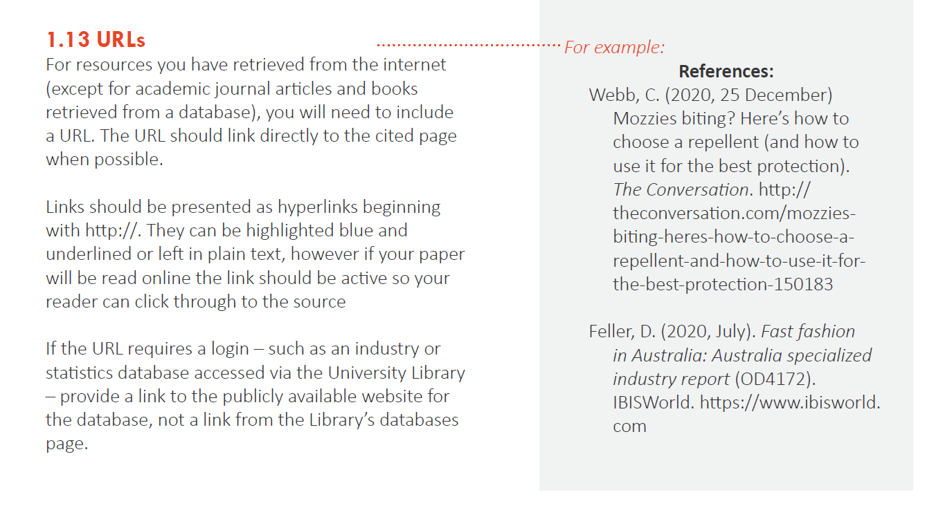

Slide 51
